Slide 1
Total Dissolve Solid (TDS)
Sharing Technical
R & D TEU Division
Last update : 2 June 2025

Slide 2





Outline
1
Introduction
2
Chemical Recovery
3
Evaluation of TDS
4
Conclusion
R & D TEU Division
Confidential – for Internal use only

Slide 3
Outline
Background
Total Dissolve Solid (TDS) is key parameters in the kraft recovery cycle, especially before the recovery boiler.
High TDS can cause operational inefficiencies (Impact to LUC).
Objective
To provide clear understanding of what TDS & Role in kraft pulp process.
To share actual plant data & trend related to TDS monitoring.
To promote awareness and best practices for optimizing TDS.
R & D TEU Division
Confidential – for Internal use only

Slide 4
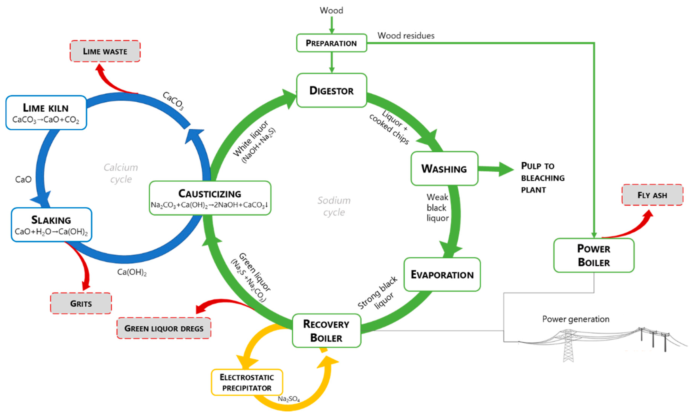
Chemical Recovery Kraft Pulp Cycle
R & D TEU Division
Scope TDS
Confidential – for Internal use only

Slide 5
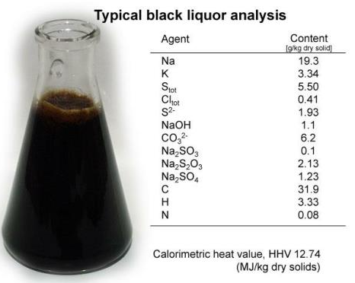
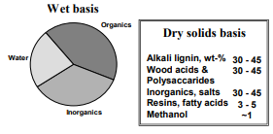
Black Liquor Properties
Inorganics
Organics
Liquors Properties in Mill
Area |  | Total Solid | Density |  | Organic Content | Caloric Value | Na | K | CL-
 |  | % | g/cm3 | Temp C | % DB | KCal/Kg (DB) | % DB | % DB | % DB
WBL FL-8 |  | 15.7 | 1.09 | 29.96 | 62.3 | 3333 | 18.74 | 1.59 | 0.56
HBL VE-12 |  | 75.1 | 1.51 | 29.48 | 62.3 | 3325 | 19.89 | 1.96 | 0.64
R & D TEU Division
Confidential – for Internal use only

Slide 6
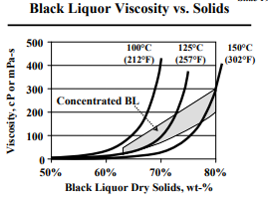
Black Liquor Properties
As solid content increases, the viscosity increases sharply.
At higher temperatures, the viscosity is lower for the same solids content
This means heating the BL can help reduce viscosity, which is important for pump to spray gun.
How To Reduction of Viscosity :
By increasing temperature of the liquor. Therefore in any case, strong black liquor temperature is not allowed to go below 90°C to avoid transport & storage problems. Normally 11O°C ~ 120°C is kept for spraying black liquor at recovery furnace.
Decrease of Concentration, Therefore decreasing solid content is not attempted with a view to decrease viscosity.
Increasing residual alkali, Work has already been done to increase the residual alkali of black liquor for hard wood. The data indicate that how residue active alkali decrease the viscosity. It is also suggested that minimum residual active alkaIi to be maintained is 6 gpl. (Ray, Dkk., 1992)
R & D TEU Division
Confidential – for Internal use only

Slide 7
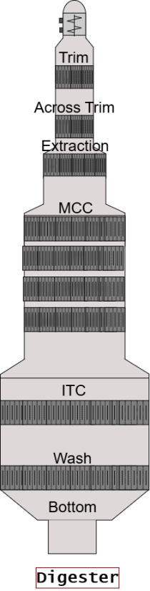
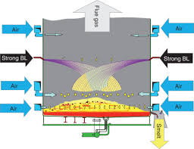
TDS Flowchart Perawang Mills
Fiberline
Pulp Production
9,024 Wet
8,981 HTW
WBL Stock
HBL Stock
RB Firing
VE Process
Sampling point
Sampling point
Sampling point
WBL volume | A | 82,194 | m³
Total Solid | B | 14.10 | %
TDS | C | 12,170 | TDS
TDS Ratio | - | 1.35 | TDS/Adt
HBL Product | G | 11,168 | m³
Total Solid | H | 76.1 | %
TDS | I | 11,081 | TDS
HBL Firing | J | 13,461 | m³
Temp HBL | K | 132.5 | ºC
Total Solid | L | 75.0 | %
TDS | M | 14,703 | TDS
TDS Ratio Wet | N | 1.45 | TDS/Adt Wet Pulp
TDS Ratio HTW | O | 1.45 | TDS/Adt HTW Pulp
Sampling point
WBL Feed | D | 25,105 | m³
Total Solid | E | 14.13 | %
TDS | F | 3,717 | TDS
I = G*%H*(1+0.0062*H-0.0005*120)*0.92
C = A * %B * (1+0.0062 * B – 0.0005 * 80)
F = D * %E * (1+0.0062 * E – 0.0005 * 80)
1
M = J*%L*(1+0.0062*L-0.0005*K)*0.92
R & D TEU Division
Note :
Density = (1+0.0062*Total Solid(%) – 0.0005*Temperature)
Confidential – for Internal use only

Slide 8
Breakdown Calculation TDS
1. HPD Formula : Flow HBL M3 x TS/100 x density x 0.92 x 24
ρ / SpGr formula : (TS x 6.2 + 1000 – Temperature HBL / 2) / 1000
Constanta 0.92 : Solid 92 % (Ash 8%)
Time Calculation : 24 Hours
TS (%) : Total Solid based on Lab results
Example RB 6 : 11 Dec 2024
Flow HBL : 164 M³/Hr
TS : 73.6%
Temp. HBL : 134.2 ºC
Calculate : 164 x (73.6/100) x (73.6 x6.2+1000 – 134.2/2)/1000) x 0.92 x 24
: 164 x (73.6/100) x 1,389 / 1000 x 0.92 x 24 = 3,702 TDS
!
Remarks :
black liquor density can be determined using total solid (%) and temperature (ºC) correlation.
R & D TEU Division
Confidential – for Internal use only

Slide 9
Attachment
R & D TEU Division
Confidential – for Internal use only

Slide 10
Evaluation of TDS
Parameter | Unit | Jan-24 | Feb-24 | Mar-24 | Apr-24 | May-24 | Jun-24 | Jul-24 | Aug-24 | Sep-24 | Oct-24 | Nov-24 | Dec-24 | Jan-25 | Feb-25 | Mar-25 | 2024 | 2025
Pulp Production | ADT/D | 8,191 | 8,674 | 8,431 | 8,666 | 8,701 | 8,619 | 8,416 | 8,307 | 8,589 | 8,319 | 6,936 | 8,761 | 8,768 | 8,695 | 8,905 | 8,384 | 8,789
Kappa Number | - | 19.2 | 19.2 | 18.5 | 17.8 | 18.0 | 18.0 | 17.8 | 17.8 | 18.3 | 18.5 | 19.1 | 18.9 | 19.1 | 19.0 | 19.4 | 18.4 | 19.1
WL Cooking | Kg/Adt | 306 | 300 | 301 | 312 | 309 | 308 | 304 | 312 | 310 | 306 | 305 | 301 | 298 | 295 | 302 | 306 | 298
WBL Ratio | m³/Adt | 9.39 | 9.35 | 9.40 | 9.43 | 9.28 | 9.14 | 9.22 | 9.21 | 9.34 | 9.14 | 9.52 | 9.12 | 9.05 | 8.96 | 8.98 | 9.3 | 9.0
Total Solid WBL | % | 13.93 | 14.21 | 14.05 | 14.22 | 14.08 | 14.28 | 14.40 | 14.20 | 14.08 | 14.03 | 13.64 | 14.07 | 14.14 | 14.31 | 14.48 | 14.1 | 14.3
Organic TS WBL | % DB | 61.15 | 61.95 | 62.61 | 61.97 | 61.77 | 61.95 | 62.05 | 62.05 | 61.54 | 62.40 | 61.58 | 61.65 | 61.83 | 62.16 |  | 61.9 | 62.0
Total Solid HBL Firing | % | 73.8 | 73.7 | 74.2 | 73.6 | 73.3 | 72.9 | 72.5 | 73.0 | 73.1 | 72.7 | 73.3 | 73.6 | 74.1 | 74.6 | 74.9 | 73.3 | 74.5
Volume WBL to VE | m³/day | 76,919 | 81,135 | 79,181 | 81,709 | 80,700 | 78,721 | 77,448 | 76,774 | 80,167 | 75,985 | 66,574 | 79,872 | 79,273 | 77,862 | 79,923 | 77,932 | 79,019
Volume HBL Firing | m³/day | 13,368 | 14,457 | 13,810 | 14,206 | 13,905 | 14,223 | 14,028 | 13,736 | 14,172 | 13,482 | 11,349 | 14,091 | 14,067 | 13,930 | 14,357 | 13,736 | 14,118
Total Net firing | TDS/D | 12,605 | 13,632 | 13,130 | 13,381 | 13,006 | 13,217 | 12,950 | 12,796 | 13,225 | 12,490 | 10,622 | 13,445 | 13,606 | 13,591 | 14,094 | 12,875 | 13,764
TDS Ratio | TDS/Adt | 1.55 | 1.57 | 1.55 | 1.55 | 1.51 | 1.53 | 1.54 | 1.54 | 1.53 | 1.50 | 1.55 | 1.54 | 1.55 | 1.57 | 1.58 | 1.54 | 1.57
Steam Production | Ton | 41,114 | 43,858 | 42,464 | 43,810 | 43,101 | 43,773 | 42,878 | 41,945 | 43,848 | 41,725 | 35,400 | 44,272 | 43,564 | 42,615 | 43,853 | 42,349 | 43,344
Steam Ratio | Ton/TDS | 3.26 | 3.22 | 3.23 | 3.27 | 3.31 | 3.31 | 3.31 | 3.28 | 3.31 | 3.34 | 3.35 | 3.34 | 3.26 | 3.19 | 3.17 | 3.29 | 3.21
R & D TEU Division
Confidential – for Internal use only

Slide 11
Evaluation of TDS - Blow Line Kappa , WL Oxidation consumption and TDS
Higher Kappa number reduce WL cooking consumption.
R & D TEU Division
Confidential – for Internal use only

Slide 12
Evaluation of TDS - Pulp Production , TDS & WBL To Ve
WBL Total Solid Increase start Jan 25 From 14.07 to 14.48 %, impacted to TDS Ratio.
R & D TEU Division
Confidential – for Internal use only

Slide 13
Evaluation of TDS - Pulp Production , TDS & HBL
HBL Firing Total Solid Increase start Jan 25 From 73.6 to 74.9 %, impacted to increase TDS Ratio.
R & D TEU Division
Confidential – for Internal use only

Slide 14
Evaluation of TDS - TDS & Organic Content in TS WBL
Organic content in TS WBL increase Dec 24 – Feb 25.
Increase Total Solid WBL start Jan – Mar 25, 14.1 to 14.5 %
R & D TEU Division
Confidential – for Internal use only

Slide 15
Attachment
R & D TEU Division
Confidential – for Internal use only

Slide 16
Formula TDS Perawang Mills
Area | Item | Nota | Unit | Remark
FL | Prod Wet Pulp | A | Adt | Totalizer on 06:00
 | Prod HTW | A1 | Adt | Totalizer on 06:00
 | Blow Line Kappa | - | - | Lab Testing - Avg weighted
 | WL Cooking | - | kg/adt | Totalizer Avg FL+RC - Cal
 | WBL to VE, FL | B | m³ | Totalizer on 06:00
 | WBL Ratio | C | m³/Adt | C = B / A
 | TS WBL to VE,FL | D | % | Lab Testing - Avg weighted
 | TDS Sent to VE, FL | E | TDS | E = B * %D * (1 + 0.0062*D - 0.0005*80)
 | TDS Ratio - FL | F | TDS/Adt | F = E / A
VE | Volume WBL Stock, VE | G | m³ | Tank Level - 06:30
 |  | H | Δ Stock | H = G_{today} - G_{Y'day}
 | TDS in WBL Stock VE | I | TDS | I = G * %K * (1 + 0.0062*K - 0.0005*80)
 | Volume WBL Feed VE | J | m³ | Totalizer on 06:00
 | TS WBL Feed VE | K | % | Lab Testing - Avg weighted
 | TDS in WBL Feed to VE | L | TDS | L = J * %K * (1 + 0.0062*K - 0.0005*80)
 | Volume HBL Stock at VE | M | m³ | Tank Level - 06:30
 | TS HBL at VE | N | % | Lab Testing - Avg weighted
 | TDS in HBL Stock at VE | O | TDS | O = M * %N * (1 + 0.0062*N - 0.0005*120) * 0.92
 |  | P | Δ Stock | P = O_{today} - O_{Y'day}
 | HBL Production | Q | m³ | Q = P + U
 | TDS Production VE | R | TDS | R = Q * %N * (1 + 0.0062*N - 0.0005*120) * 0.92
 | Ratio WBL to HBL | S | m³/m³ | S = J / Q
RB | Total TDS Production | T | TDS | Reff. to Sheet TDS Cal;Row 63
 | Volume HBL Firing | U | m³ | Reff. to Sheet TDS Cal;Row 62
 | Temperature HBL Firing | - | °C | Reff. to Sheet TDS Cal;Row 90
 | TS HBL Firing | - | % | Reff. to Sheet TDS Cal;Row 89
 | TDS HBL Firing | V | TDS | Reff. to Sheet TDS Cal;Row 56
 | TDS Ratio Wet Pulp | W | TDS/Adt | W = T / A
 | TDS Ratio HTW | AA | TDS/Adt | W = T / A1
R & D TEU Division
Confidential – for Internal use only

Slide 17
Formula TDS Perawang Mills
Area | Item | Nota | Unit | Remark
FL | Prod Wet Pulp | A | Adt | Totalizer on 06:00
 | Prod HTW | A1 | Adt | Totalizer on 06:00
 | Blow Line Kappa | - | - | Lab Testing - Avg weighted
 | WL Cooking | - | kg/adt | Totalizer Avg FL+RC - Cal
 | WBL to VE, FL | B | m³ | Totalizer on 06:00
 | WBL Ratio | C | m³/Adt | C = B / A
 | TS WBL to VE,FL | D | % | Lab Testing - Avg weighted
 | TDS Sent to VE, FL | E | TDS | E = B * %D * (1 + 0.0062*D - 0.0005*80)
 | TDS Ratio - FL | F | TDS/Adt | F = E / A
VE | Volume WBL Stock, VE | G | m³ | Tank Level - 06:30
 |  | H | Δ Stock | H = G_{today} - G_{Y'day}
 | TDS in WBL Stock VE | I | TDS | I = G * %K * (1 + 0.0062*K - 0.0005*80)
 | Volume WBL Feed VE | J | m³ | Totalizer on 06:00
 | TS WBL Feed VE | K | % | Lab Testing - Avg weighted
 | TDS in WBL Feed to VE | L | TDS | L = J * %K * (1 + 0.0062*K - 0.0005*80)
 | Volume HBL Stock at VE | M | m³ | Tank Level - 06:30
 | TS HBL at VE | N | % | Lab Testing - Avg weighted
 | TDS in HBL Stock at VE | O | TDS | O = M * %N * (1 + 0.0062*N - 0.0005*120) * 0.92
 |  | P | Δ Stock | P = O_{today} - O_{Y'day}
 | HBL Production | Q | m³ | Q = P + U
 | TDS Production VE | R | TDS | R = Q * %N * (1 + 0.0062*N - 0.0005*120) * 0.92
 | Ratio WBL to HBL | S | m³/m³ | S = J / Q
RB | Total TDS Production | T | TDS | Reff. to Sheet TDS Cal;Row 63
 | Volume HBL Firing | U | m³ | Reff. to Sheet TDS Cal;Row 62
 | Temperature HBL Firing | - | °C | Reff. to Sheet TDS Cal;Row 90
 | TS HBL Firing | - | % | Reff. to Sheet TDS Cal;Row 89
 | TDS HBL Firing | V | TDS | Reff. to Sheet TDS Cal;Row 56
 | TDS Ratio Wet Pulp | W | TDS/Adt | W = T / A
 | TDS Ratio HTW | AA | TDS/Adt | W = T / A1
R & D TEU Division
Confidential – for Internal use only

